Slide 1


ARTIFICIAL
INTELLIGENCE
SMART TRAFFIC
Group 5
Gan Heng Lai A21EC0176
Ng Kai Zheng A21EC0101
Lew Chin Hong A21EC0044
Yeo Chun Teck A21EC0148

Slide 2
PROBLEM STATEMENT
Delayed accident reporting
Parking inefficiencies
Confusing toll payments
Compromised road safety and driver inconvenience
Existing systems lead to delayed reporting of accidents, hindering prompt emergency responses and bystander interventions.
Drivers face challenges in locating available parking spots efficiently, leading to congestion and frustration.
Various payment methods at toll booths in Malaysia result in confusion, long queues, and potential issues for drivers during peak hours.
Lack of signage, delayed accident reporting, and parking issues impact road safety for drivers.

Slide 3
Emphasize Phase
Define Phase
Identify driver needs for immediate assistance and real-time accident information.
Understand perspectives of drivers and the Ministry of Transport.
Crucial insights from this phase shape SmartTraffic's features.
Uncover user expectations for immediate assistance, automatic toll payment, and easy parking solutions.
Insights into drivers' concerns guide the integration of specific features.
SmartTraffic aligns with user expectations for a user-friendly and efficient transportation solution.

Slide 4
GOAL OF AI SOLUTION
1
Immediate Accident Detection and Reporting
2
Accident Location Signaling
3
Streamlined Parking Process
4
Automated Toll Payment
5
Vehicle Status Analysis and Reporting

Slide 5
KNOWLEDGE REPRESENTATION
Accident Detection
Accident Location Reporting
Parking Slot Detection
Rule: IF impact_detector = true AND object_sensor = true, THEN accident_status = true
Rule: IF GPS_Access = true AND accident_status = true, THEN accident_notification = true
Rule: IF parking_slot_detector = true AND parking_available_status = true, THEN parking_display = true
Parking Fee Calculation
Toll Fee Detection
Car Status Checking
Rule 1: IF car_sensor = true AND proximity_sensor = true, THEN parking_available_status = false, duration_counter = true
Rule 2: IF car_sensor = false AND proximity_sensor = false, THEN parking_available_status = true, account_charge = true
Rule: IF vehicle_detector = true AND toll_pass = true, THEN account_charge = true
Rule: IF PlatNo_Detector = true AND Roadtax_Validity = false, THEN JPJ_Report = true

Slide 6
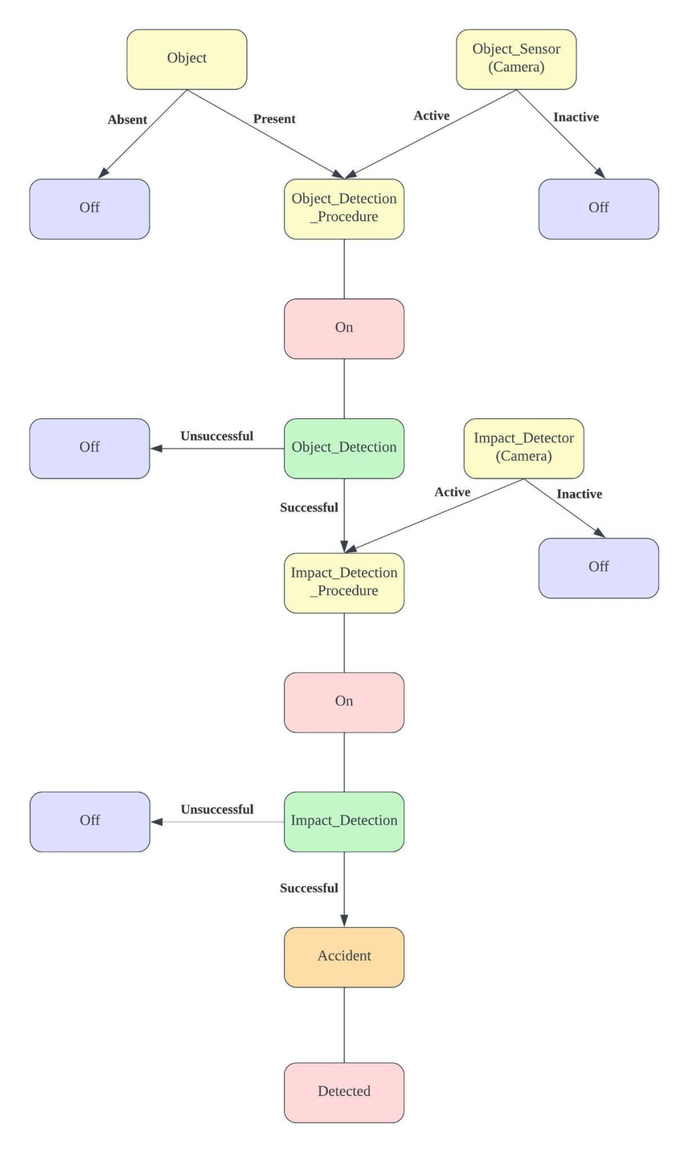
Accident Detection
Goal: Implement an AI system that promptly detects and identifies vehicle accidents using impact detectors and object sensors, enabling quick response and intervention from emergency services.

Slide 7
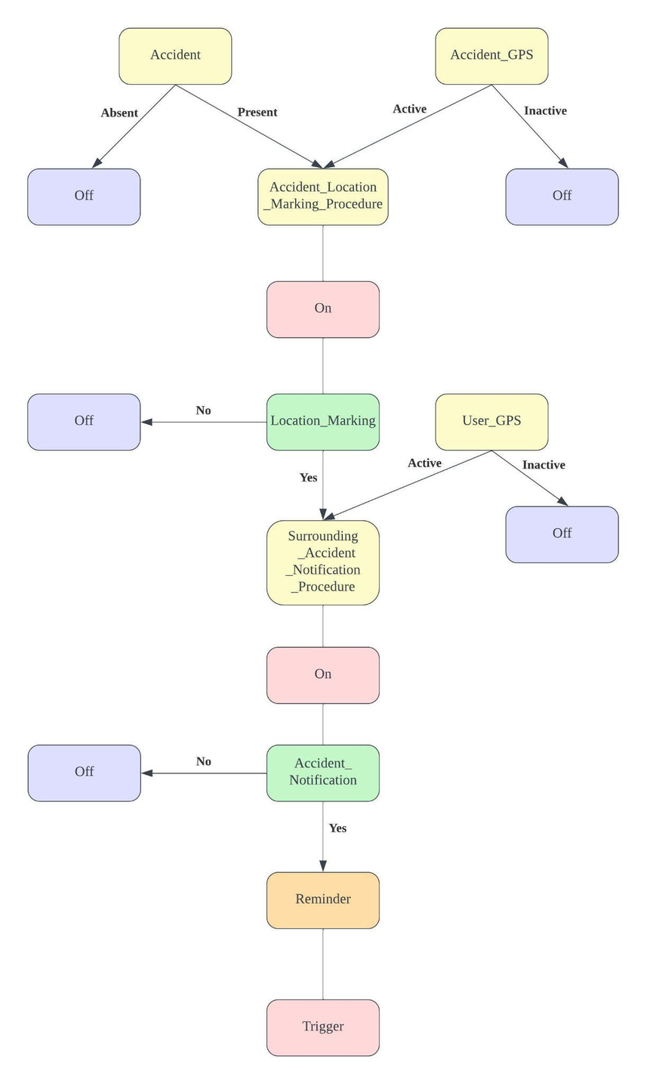
Accident Notification
Goal: Create an AI system that promptly and automatically notify relevant users about the occurrence of a detected accident based on their current location

Slide 8
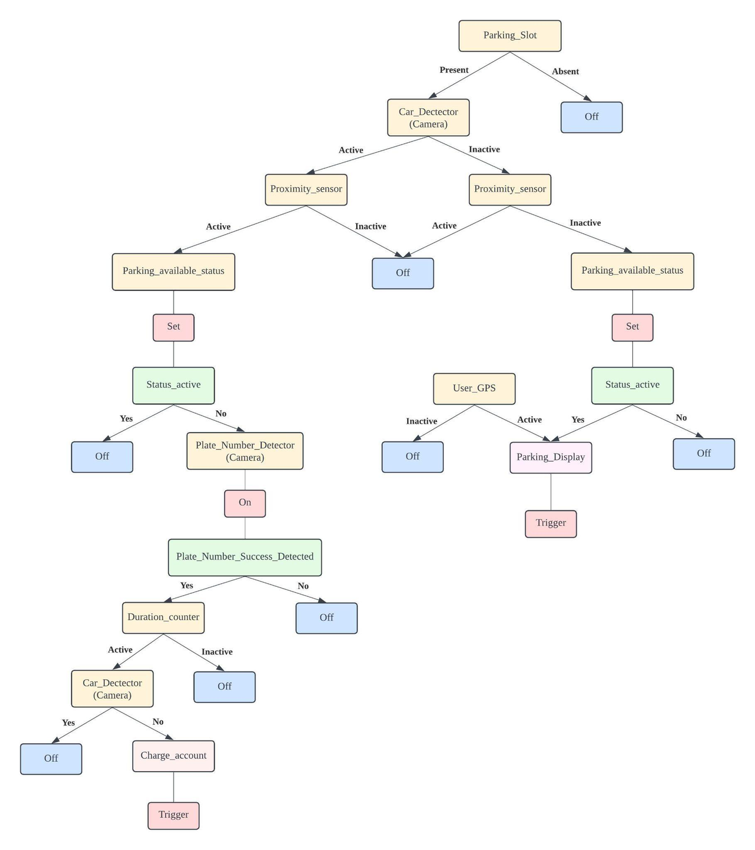
Parking Slot Detection and Parking Fee Calculation
Goal: Create an AI system that detects and displays available parking slots, aiding drivers in efficiently locating parking spaces.
Goal: Implement an AI solution to automate parking fee calculation by utilizing car sensors and proximity sensors, enhancing the user experience and streamlining the parking process.

Slide 9
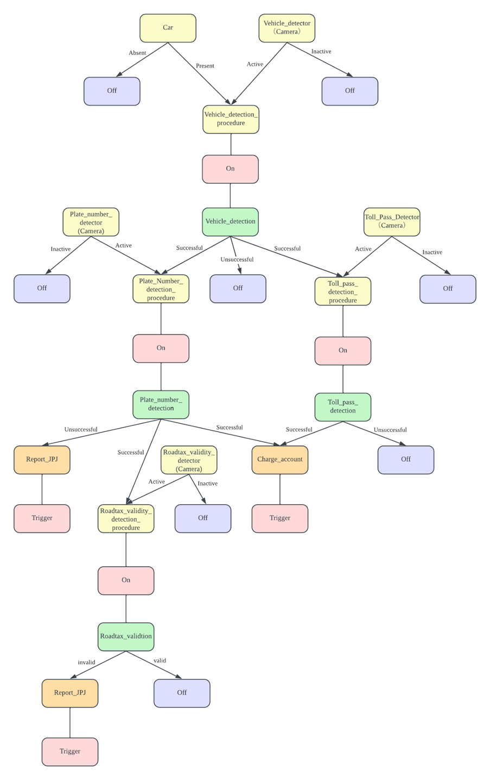
Toll Fee Detection and Car Status Checking
Goal: Develop an AI system to detect vehicles passing through toll gates with valid toll passes, automating the toll fee deduction process from user accounts.
Goal: Implement an AI solution that checks and analyzes vehicle statuses, such as road tax validity, and automatically reports any discrepancies to the relevant authorities, ensuring compliance with regulations.

Slide 10
DEFINE PEAS MODEL
Performance measure
Environment
Actuators
Sensors
Safety, Accuracy, Precision, Response Time, Reliability, Effectiveness
Vehicles, Pedestrians, Obstacles, Drivers, Roads, Road signs, Parking lot, Buildings
Notification Systems, Automated Response Mechanisms, Smart Toll Booth
Object sensor, Impact detector, GPS, Vehicle detector, Plate number detector, Toll pass detector, Road tax validity detector

Slide 11
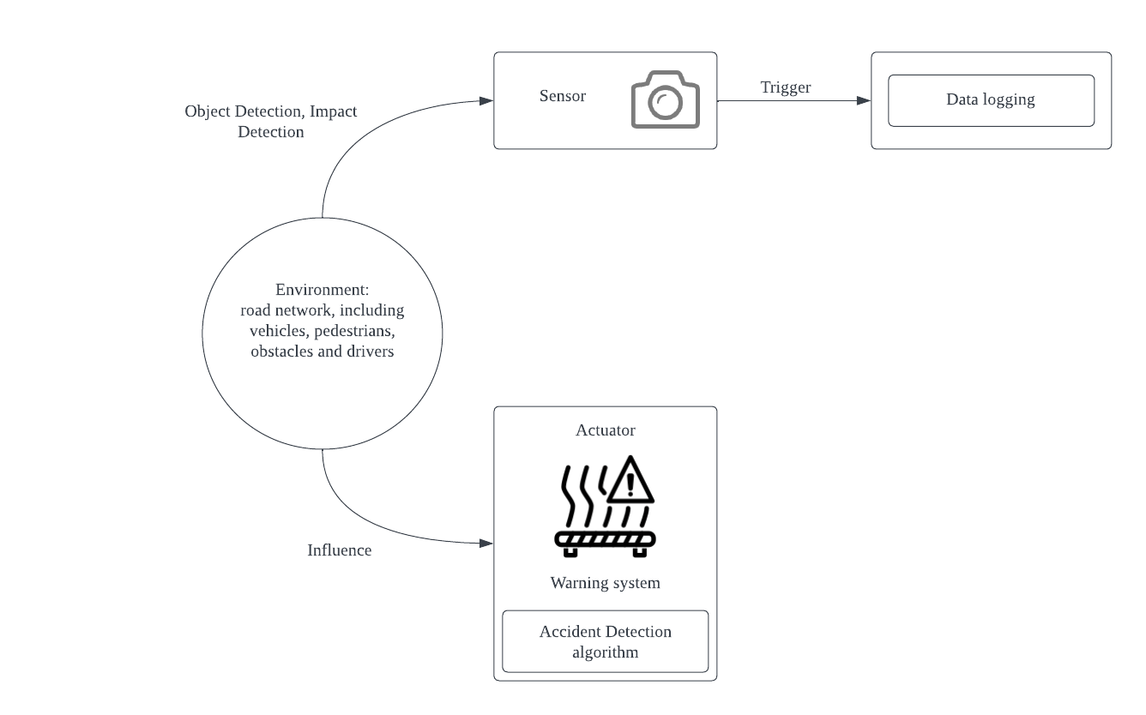
Accident DETECtion

Slide 12
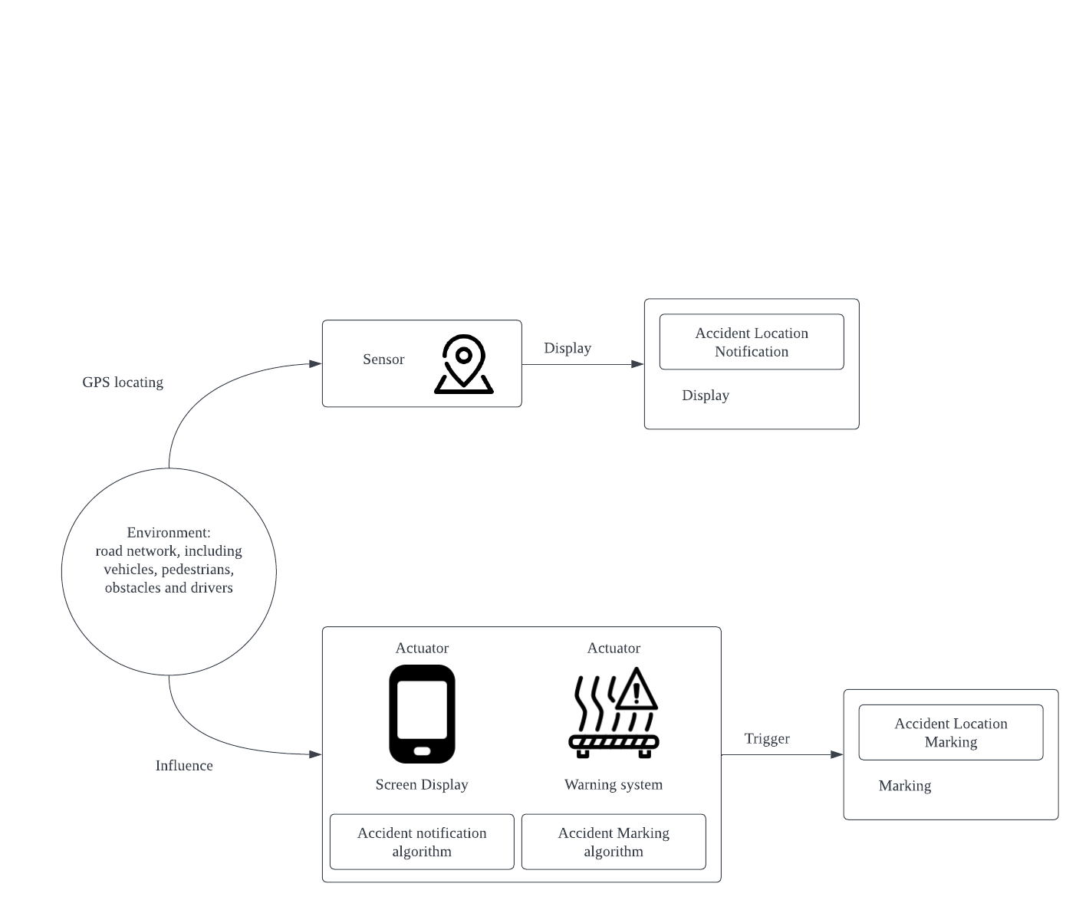
Accident notification

Slide 13
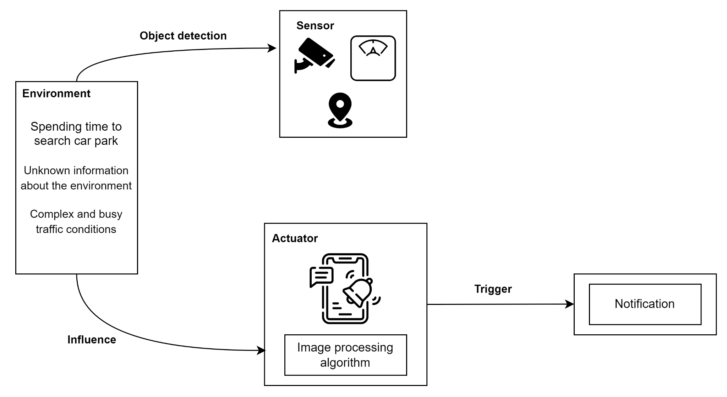
PARKING SYSTEM

Slide 14
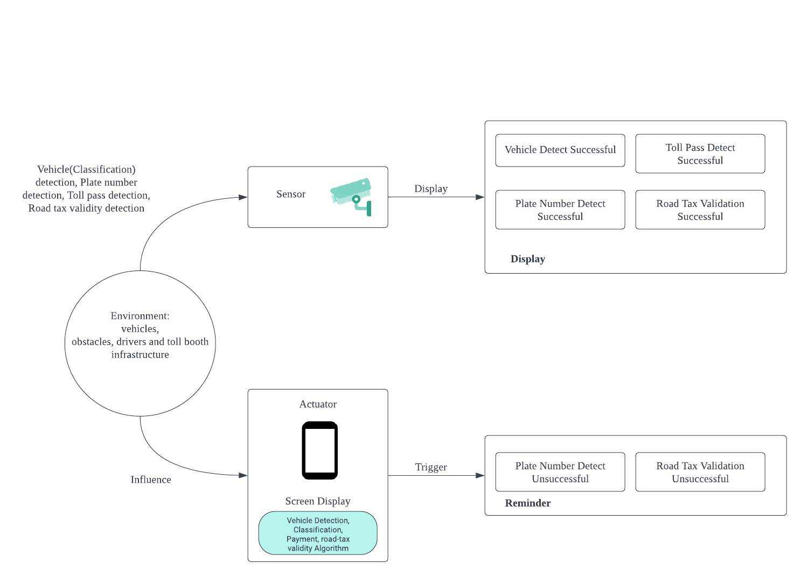
TOLL SYSTEM

